Slide 1
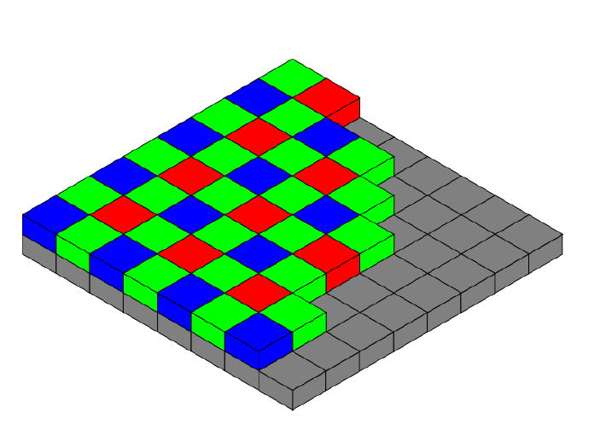
Bayer Interpolation using OpenMP
by Saidrasulkhon
ID: 22182232

Slide 2
Content
Introduction
Required task
Proposed algorithm
Result

Slide 3
Introduction
What is Bayer filter?
It is a color filter array for arranging Red, Green and Blue color filters.
Invented by Bryce Bayer in 1976
The Bayer filter is almost universal on consumer digital cameras

Slide 4
Tasks performed
Load the .raw format image
Read the file and store in a one-dimensional array
Allocate the memory space for image
Convert 8-bit image values to 10-bit
Separate each R,G and B channels
Interpolate each channel
Interpolate using OpenMP
Convert to OpenCV Mat format
Save the image
Create the GUI using Qt

Slide 5
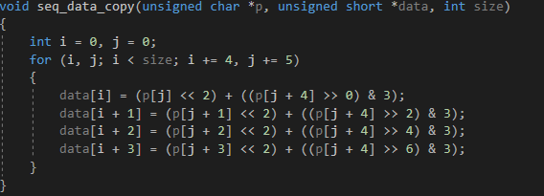
8 bit to 10 bit
The code was given that this code convert the 8-bit data to 10-bit

Slide 6
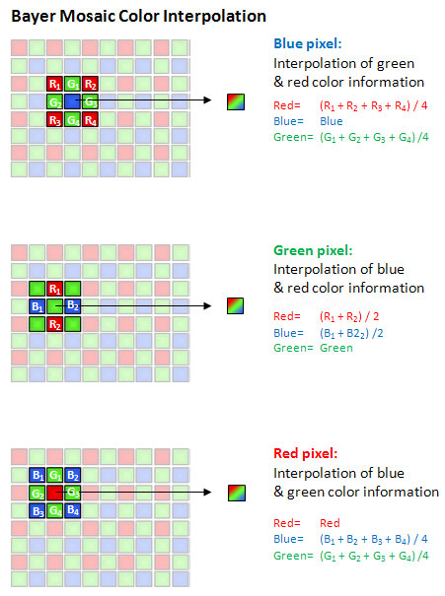
Image interpolation
After separation image to individual channel I had 2D array of values of each channel
To calculate missing values of channels we must use formula of
averaging

Slide 7
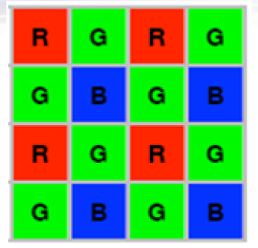
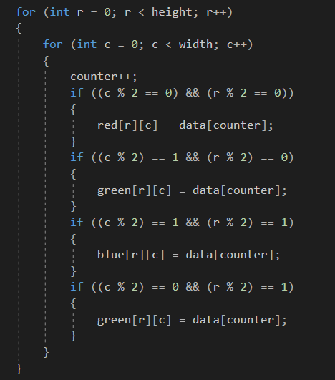
Proposed algorithm
Since I know the position of each R, G and B channels I separated them into three different unsigned short variables
This code is to separate channels from 10-bit unsigned short variable

Slide 8
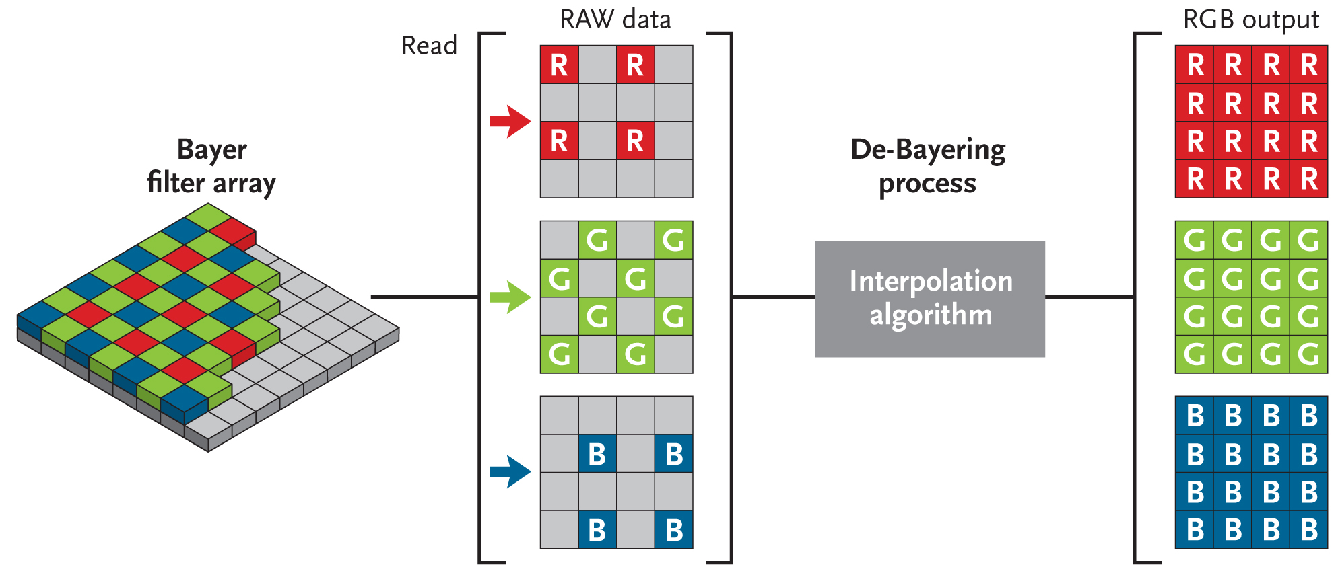
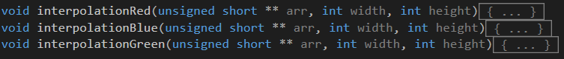
Interpolation method
I must have filled missing pixel values by averaging the
values of each channel
I used separate functions to interpolate each channel

Slide 9
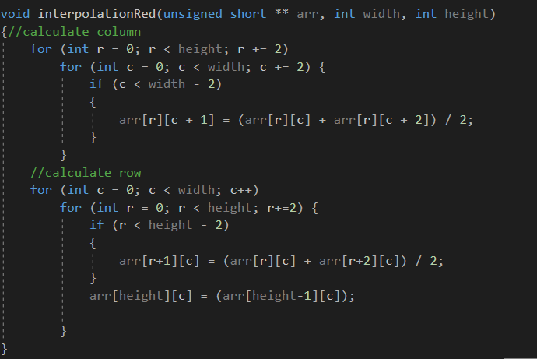
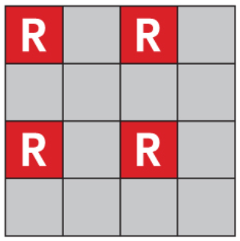
Interpolation algorithm Red
First, I calculate the values by column and then I calculated values by row.
1
1
2
2

Slide 10
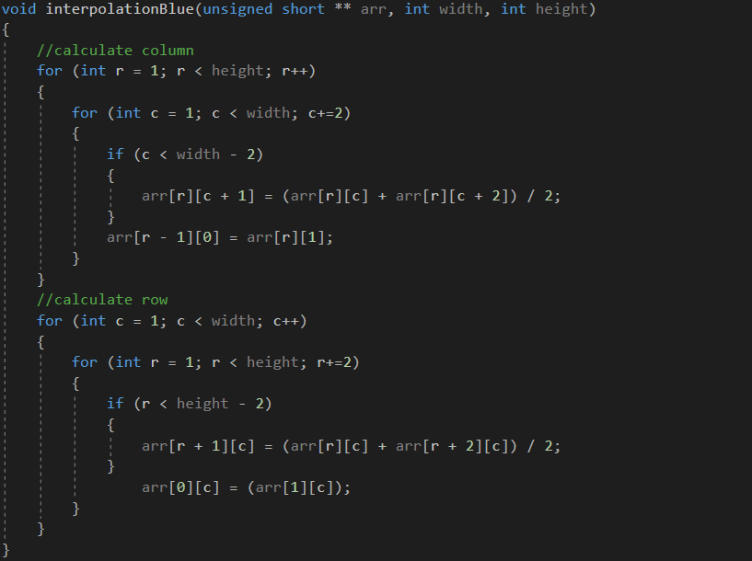
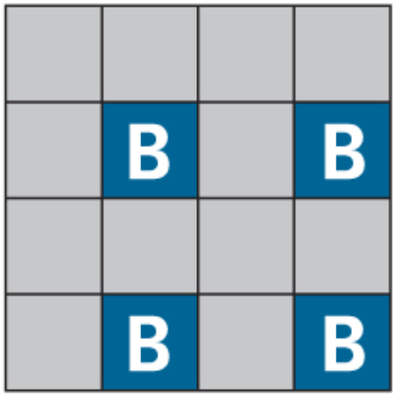
Interpolation algorithm Blue
I used almost same calculation algorithm for blue with some minor changes
2
1
2
1
Same as red I calculated first column then row

Slide 11
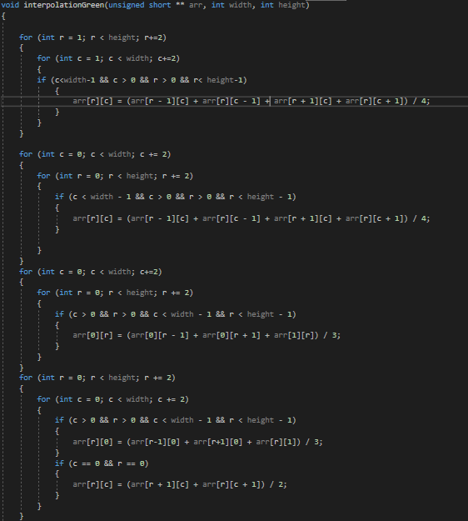
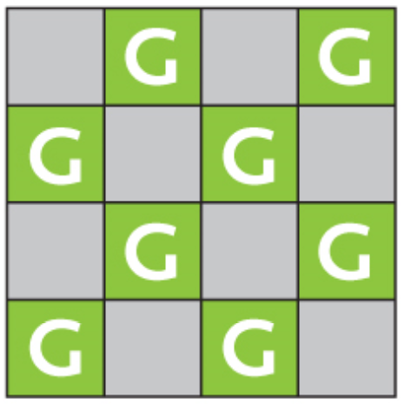
Interpolation algorithm Green
To interpolate green channel I had to calculate it using different formula
3
2
First, I calculated the cases where I should calculate average of four border values then I calculated corners with border line
1
2
2
1
2
3

Slide 12
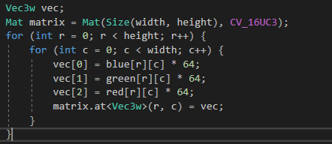
OpenCV format conversion
This code is enabling me to convert the unsigned short array to Mat format to see the expected image.

Slide 13
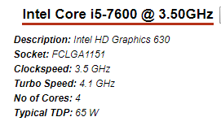
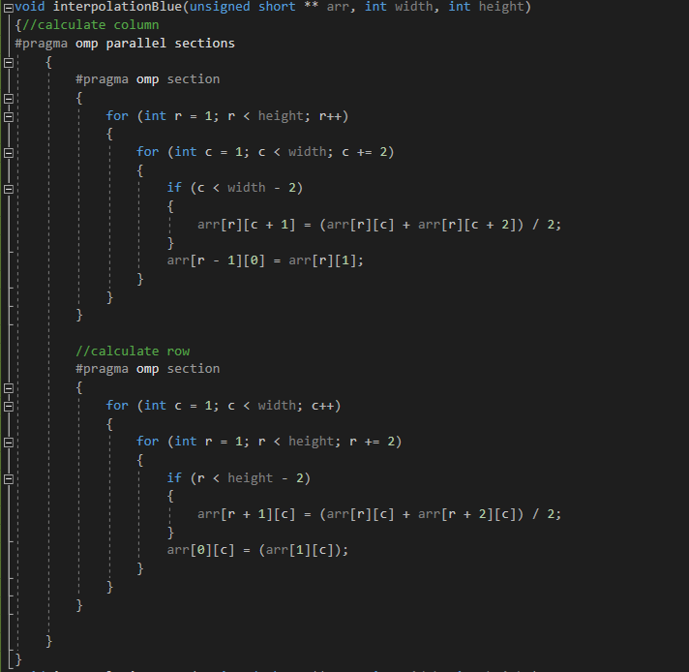
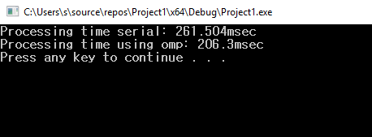
Processing time Serial VS Parallel
Processing time wasn’t much different when I used
omp and serial.
For parallel processing I used omp sections to calculate each for loop in different sections
omp_set_num_threads(4).

Slide 14
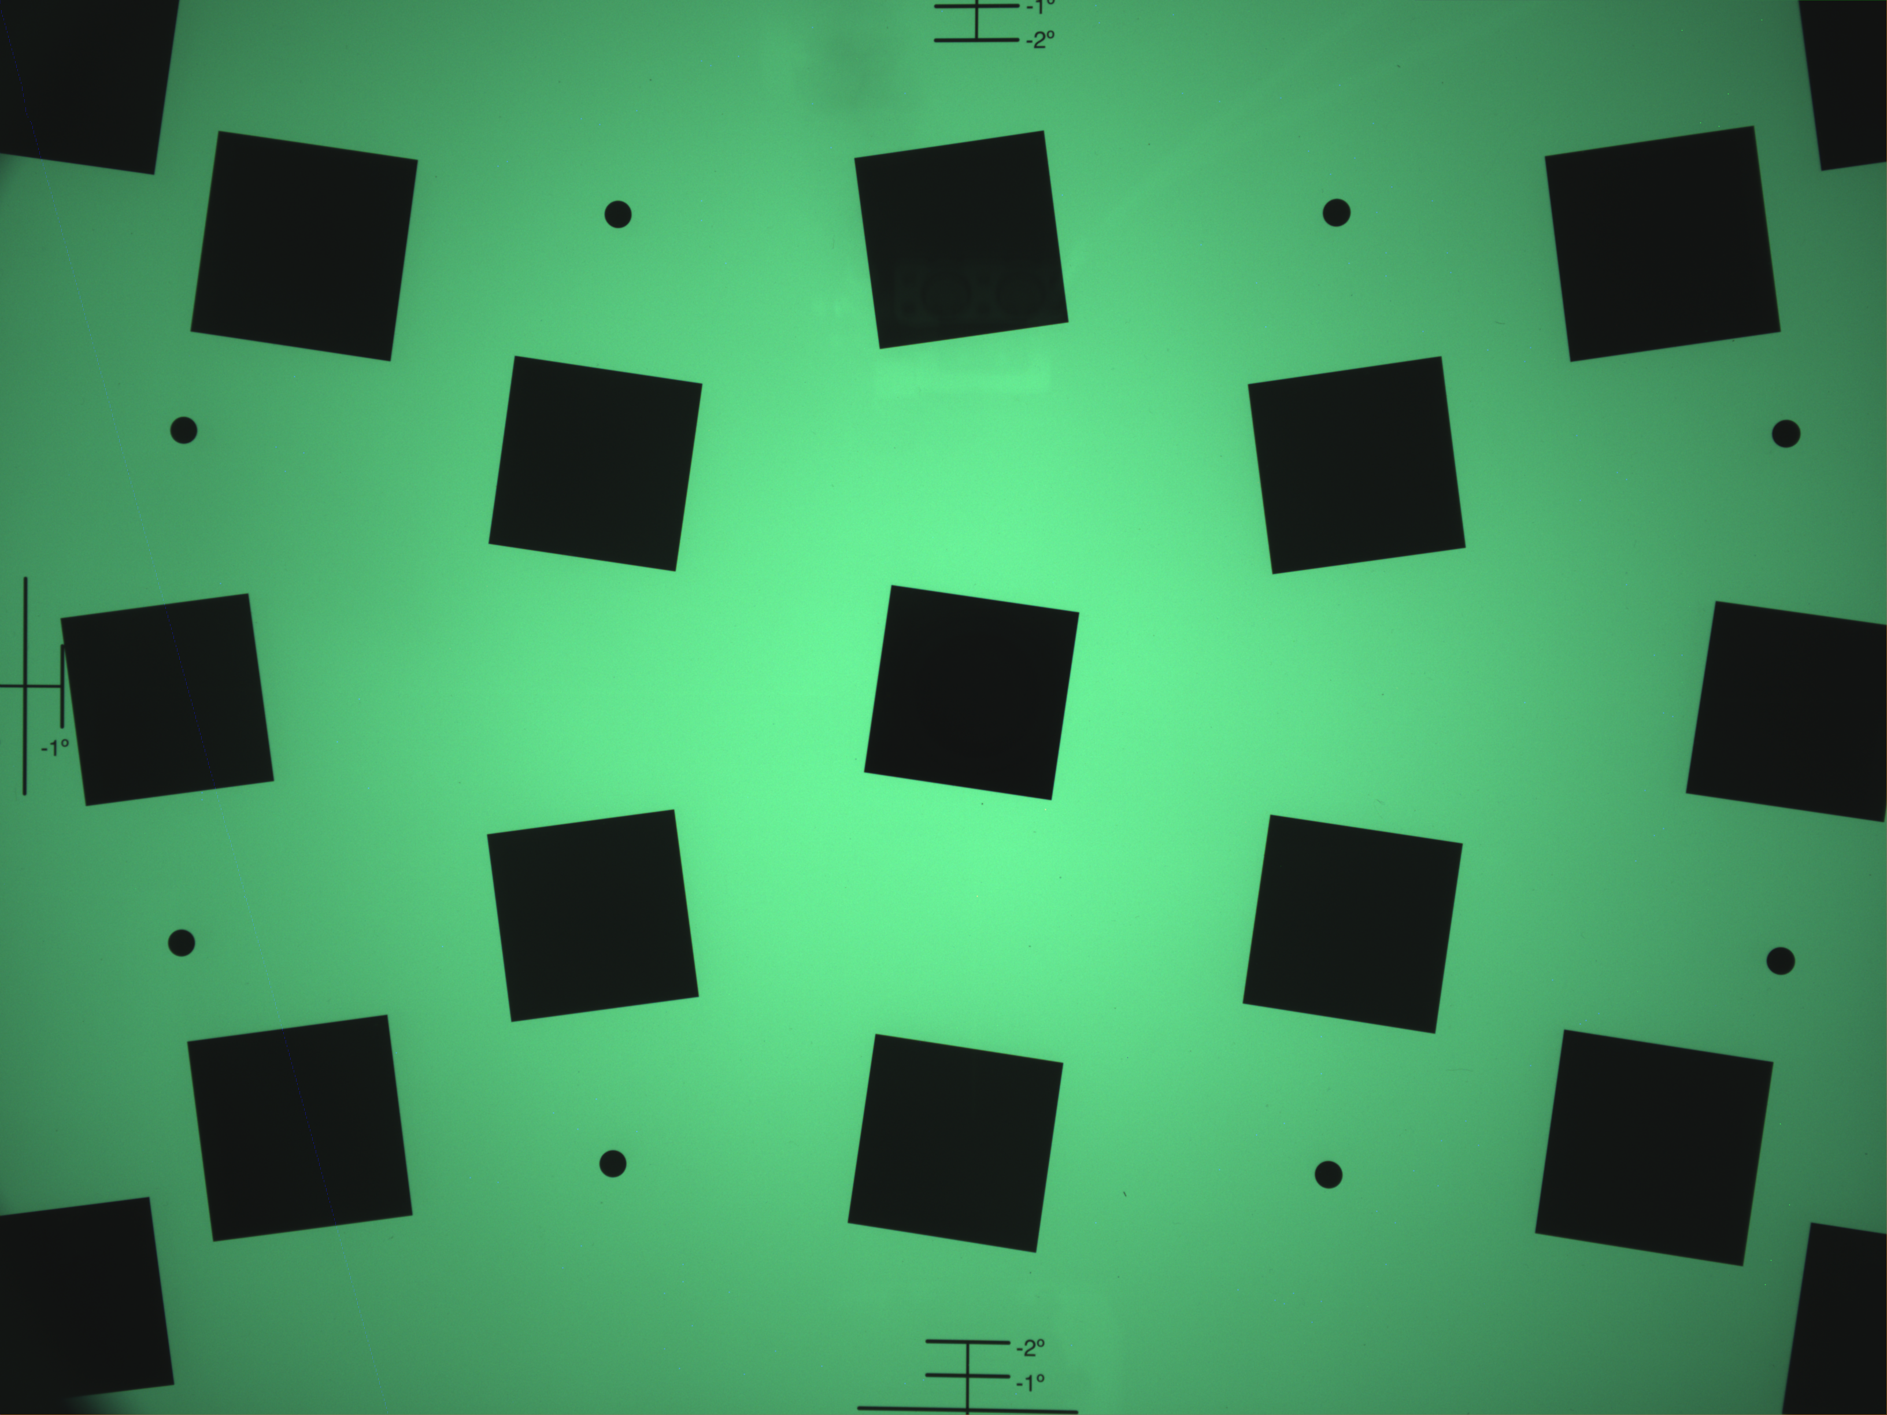
Result image

